Slide 1
Introduction to Biochemistry of Nutrition
Prof K Syed
Department of Biochemistry & Microbiology
University of Zululand
Room no. 247
SyedK@unizulu.ac.za

Slide 2
Topics
Nutritional Biochemistry
Importance of food
How the body uses food
Cellular respiration
Energy systems
Nutrition basics - terminology

Slide 3
Biochemistry of nutrition
Biochemistry, sometimes called biological chemistry, is the study of chemical processes within and relating to living organisms. Biochemical processes give rise to the complexity of life
Nutrition is the science that interprets the interaction of nutrients and other substances in food in relation to maintenance, growth, reproduction, health and disease of an organism. It includes food intake, absorption, assimilation, biosynthesis, catabolism, and excretion
Nutritional Biochemistry takes a scientific approach to nutrition. It covers not just "whats"--nutritional requirements--but why they are required for human health, by describing their function at the cellular and molecular level
or
Nutritional biochemistry is the study of nutrition as a science. Nutritional biochemistry deals with various studies in nutrients, food constituents and their function regarding humans and other mammals, nutritional biochemistry specifically focuses on nutrient chemical components, and how they function biochemically, physiologically, metabolically, as well as their impact on disease
Play video: What is nutrition

Slide 4
Importance of food
Food is an essential part of everyone’s lives. It gives us the energy and nutrients to grow and develop, be healthy and active, to move, work, play, think and learn
The body needs a variety of the following 5 nutrients
Protein - is needed to build, maintain and repair muscle, blood, skin and bones and other tissues and organs in the body. Foods rich in protein include meat, eggs, dairy and fish.
Carbohydrate - provides the body with its main source of energy. Carbohydrates can be classified into two kinds; starches and sugars. Food rich in starches include rice, maize, wheat and potatoes and food rich in sugars include fruit, honey, sweets and chocolate bars.
Fat - This is the body's secondary source of energy. Fat actually provides more energy/calories per gram than any other nutrient, but is more difficult to burn. Food rich in fats are oils, butter, lard, milk, cheese and some meat.
Vitamins and Minerals - Vitamins and minerals are needed in very small amounts and are sometimes called micronutrients, but are essential for good health. They control many functions and processes in the body, and in the case of minerals also help build body tissue such as bones (calcium) and blood (iron).
In addition to the above nutrients Fiber and Water are also essential for a good healthy diet.
Play videos: What do we eat & Gotta Eat

Slide 5
How body uses food
• Carbohydrates into sugars
• Proteins into amino acids
• Fats into fatty acids and glycerol
• The body uses these basic units to build substances it needs for growth, maintenance, and activity (including other carbohydrates, proteins, and fats)
Order of macronutrients use by the body - body burns carbohydrates, then fats, and then proteins
Play videos: How the body uses food

Slide 6
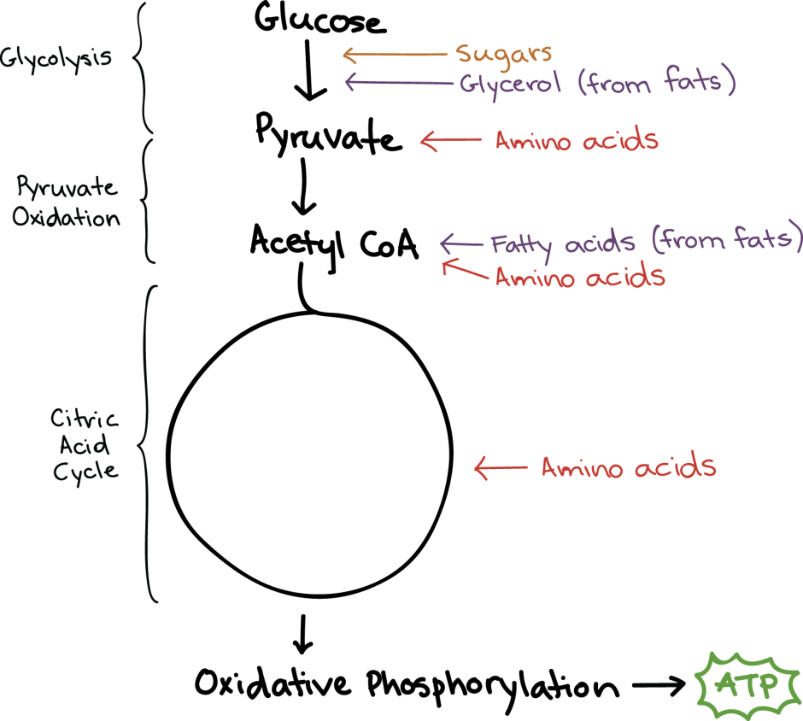
Cellular respiration
Cellular respiration is the process by which the chemical energy of "food" molecules is released and partially captured in the form of ATP.
Carbohydrates, fats, and proteins can all be used as fuels in cellular respiration
Play video: What is cellular respiration & Cellular respiration in 3D

Slide 7
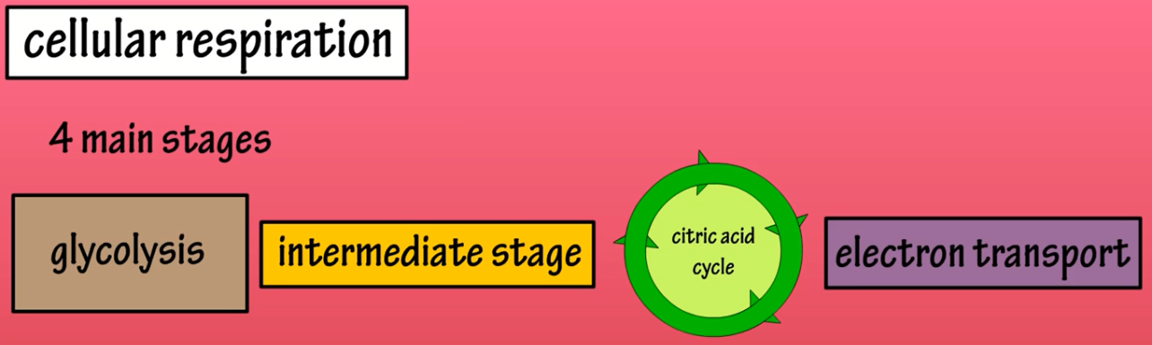
Cellular respiration
The overall reaction for cellular respiration:
C₆H₁₂O₆ + 6O₂ -------------------> 6CO₂ + 6H₂O + ~38 ATP
Glycolysis: 2 ATPs
TCA: 2 ATPs
ETC: 34 ATPs
Total: 38 ATPs (in reality 30-32 ATPs)
Play video: What is cellular respiration & Cellular respiration in 3D

Slide 8
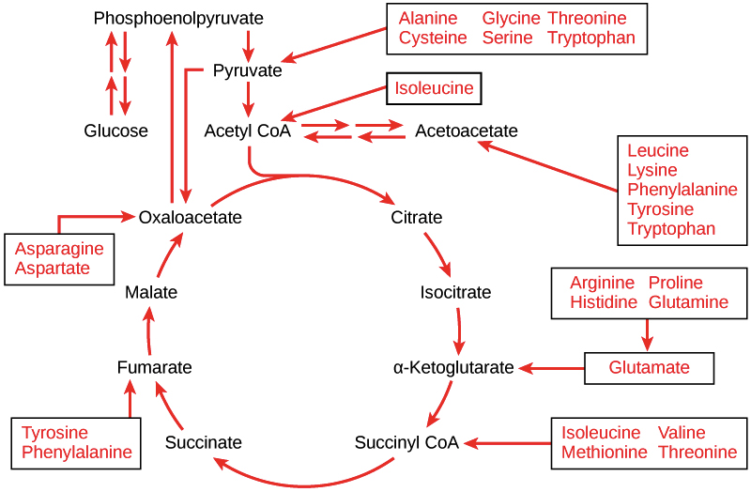
Cellular respiration
Play video: What is cellular respiration & Cellular respiration in 3D

Slide 9
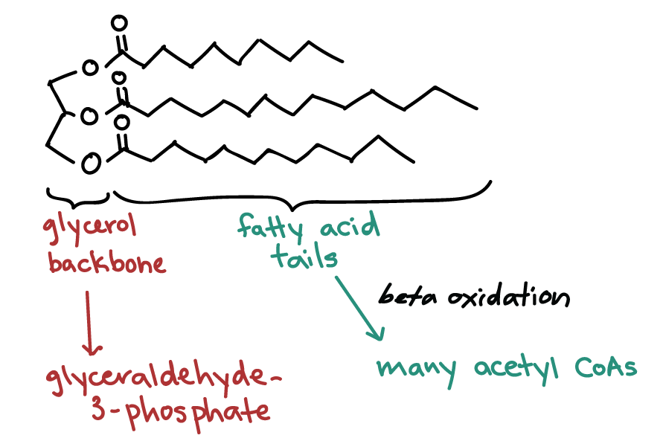
Cellular respiration
Fats, known more formally as triglycerides, can be broken down into two components that enter the cellular respiration pathways at different stages
A triglyceride is made up of a three-carbon molecule called glycerol, and of three fatty acid tails attached to the glycerol
Glycerol can be converted to glyceraldehyde-3-phosphate, an intermediate of glycolysis
Fatty acids, on the other hand, must be broken down in a process called beta-oxidation
Play video: What is cellular respiration & Cellular respiration in 3D

Slide 10
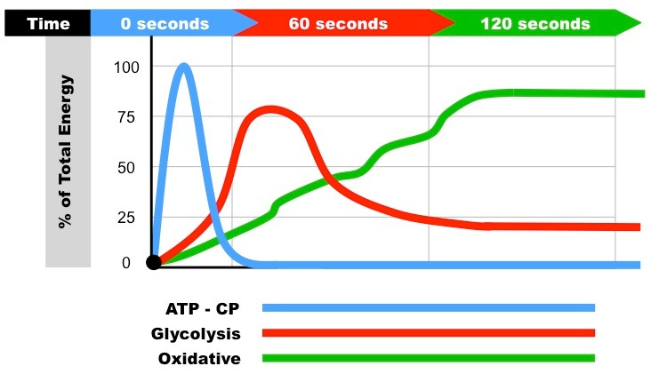
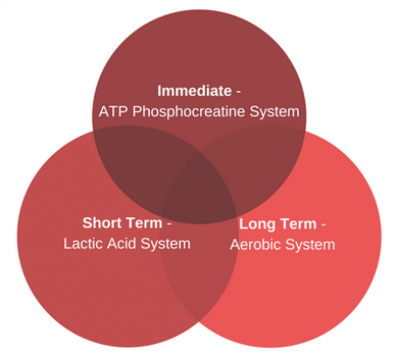
Energy systems
Play videos: Energy system & ATP Phosphocreatine systems

Slide 11
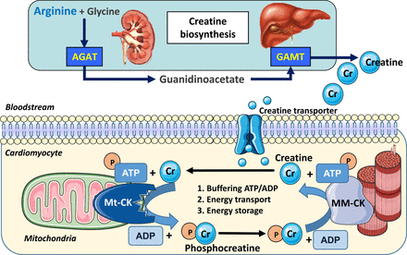
Energy systems: ATP-PC system
Play videos: Energy system & ATP Phosphocreatine systems

Slide 12
Energy systems: Glycolytic system
The three stages which will be discussed in greater detail are:
1. Aerobic glycolysis (slow glycolysis)
2. Krebs cycle (also known as the citric acid cycle)
3. Electron transport chain
Glycolysis 2 ATP
Krebs cycle 2 ATP
Electron transport chain 34 ATP
Total 38 ATP
Play videos: Energy system & ATP Phosphocreatine systems

Slide 13
Nutrition basics - Terminology
A | B
nutirition | The science of food and how the body uses it in health and disease.
essential nutrients | Substances the body must get from foods because it can't manufacture them at all or fast enough to meet its needs.
digestion | The process of breaking down foods in the gastrointestinal tract into compounds the body can absorb.
kilocalorie | A measure of energy content in food; commonly referred to as calorie
protein | An essential nutrient; a compound made of amino acids that contain carbon, hydrogen, oxygen, and nitrogen.
amino acids | The building blocks of proteins.
legumes | Vegetables such as peas and beans that are high in fiber and are also important sources of protein.
saturated fat | A fat with no carbon-carbon double bonds; usually solid at room temperature.

Slide 14
Nutrition basics - Terminology
monounsaturated fat | A fat with one carbon-carbon double bond; liquid at room temperature.
polyunsaturated fat | A fat containing two or more carbon-carbon double bonds; liquid at room temperature.
hydrogenation | A process by which hydrogens are added to unsaturated fats.
trans fatty acid | A type of unsatuarated fatty acid produced during the process of hydrogenation.
cholesterol | A waxy substance found in the blood and cells and needed for cell membranes, vitamin D, and hormone synthesis.
low-density lipoprotein (LDL) | Blood fat taht transports cholesterol to organs and tissues.
high-density lipoprotein (HDL) | Blood fat that helps transport cholesterol out of the arteries, thereby protecting against heart disease.
omega-3 fatty acids | Polyunsaturated fatty acids commonly found in fish oils that are beneficial to cardiovascular health.
carbohydrate | An essential nutrient; sugars, starches, and dietary fiber are all carbohydrates.
glucose | A simple sugar that is the body's basic fuel.

Slide 15
Nutrition basics - Terminology
glycogen | An animal starch stored in the liver and muscles.
whole grain. | The entire edible portion of a grain, including the germ, endosperm, and bran
dietary fiber | Carbohydrates and other substances in plnats that are indigestible by humans.
soluble fiber | Fiber that dissolves in water or is broken down by bacteria in the large intestine.
insoluble fiber | Fiber that does not dissolve in water and is ont broken down by bacteria in the large intestine.
diverticulitis | A disgestive disorder in which abnormal pouches form in the walls of the intestine and become inflamed.
vitamins | Carbon-containing substances needed in small amounts to help promote and regulate chemical reactions and processes in the body.
antioxidant | A substance that can lessen the breakdown of food or body constituents by free radicals.
free radical | An electron-seeking compound that can react with fats, proteins, and DNA, damaging cell membrances and mutating genes
phytochemical | A naturally occuring substance found in plant foods/may help prevent/treat chronic diseases like cancer/heart disease.

Slide 16
Nutrition basics - Terminology
cruciferous vegetables | Vegetables of the cabbage family, including cabbage, broccoli, and brussel sprouts.
Dietary Reference Intakes (DRIs) | An umbrella term for four types of nutrient standards.
Food Guide Pyramid | A food-group plan that provides practical advice to ensure a balanced intake of the essential nutrients.
Dietary Guildines for Americans | General principles of good nutrition intended to help prevent certain diet-related diseases.
Recommended Dietary Allowances (RDAs) | Amounts of certain nutrients considered adequate to prevent deficiencies in most healthy people.
Daily Values | A simplified version of the RDAs used on food labels.
vegan | A vegetarian who eats no animal products at all.
lacto-vegetarian | A vegetarian who includes milk and cheese products in the diet.
lacto-ovo-vegetarian | A vegetarian who eats no meat, poultry, or fish, but does eat eggs and milk products.
partial vegetarian, semivegetarian, or pescovegetarian | A vegetarian who includes eggs, dairy products, and small amounts of poultry and seafood in the diet.

Slide 17
Nutrition basics - Terminology
functional foods | Foods and beverages that contain biologically active compounds that provide health benefits beyond basic nutrition.
genetically modified (GM) organism | A plant, animal, or microorganism in which genes have been added, rearraged, or replaced through genetic engineering.
pathogen | A microorganism that causes disease.
polychlorinated biphenyl (PCB) | An industrial chemical used as an insulator in electrical transformers and linked to certain hu man cancers.
organic | A designation applied to foods grown and produced according to strict guidelines limiting the use of pesticides, hormones, etc.
food irradiation | Treating foods with gamma rays, X rays, or high-voltage electrons to kill potentially harmful pathogens & incr. shelf life.
food allergy | Adverse reaction to a food/food ingred. in which the immune sys. perceives a particular substance as foreign and acts to destroy it.
food intolerance | An adverse reaction to a food or food ingredient that doesn't involve the immune system.
scurvy | A disease caused by a lack of Vitamin C - bleeding gums, loosening teeth, and poor wound healing.
minerals | Inorganic compounds needed for regulation, growth and maintenance of body tissues and functions.
anemia | A deficiency in the oxygen-carrying material in the red blood cells.
osteoporosis | A condition in which the bones become extremely thin and brittle and break easily.

Slide 18
Sources
https://www.concern.net/sites/default/files/media/page/Hunger_Factsheets.pdf
http://www.fao.org/docrep/007/y5740e/y5740e04.htm
https://www.quia.com/jg/155814list.html
https://www.biology.iupui.edu/biocourses/N100/2k4ch7respirationnotes.html
https://www.ck12.org/book/CK-12-Biology/section/4.3/
https://www.khanacademy.org/science/biology/cellular-respiration-and-fermentation/variations-on-cellular-respiration/a/connections-between-cellular-respiration-and-other-pathways
What is Nutrition?: https://www.youtube.com/watch?v=uYamwNVnCVU
Why do we eat?: https://www.youtube.com/watch?v=brKgffGPfmA
Gotta Eat! – Crash Course Kids 1.1: https://www.youtube.com/watch?v=z9TIlM96lT8
How The Body Uses Food - You Are What You Eat. : https://www.youtube.com/watch?v=AA0QMn9VfoE
What Is Cellular Respiration - What Is Cellular Energy - Food Converted Into Energy – Glycolysis: https://www.youtube.com/watch?v=hMK1-bgTAtQ
Energy Systems - ATP Energy In The Body - Adenosine Triphosphate – Glycolysis: https://www.youtube.com/watch?v=dWe8vtztW-4
ATP Phosphocreatine System Overview (V2.0): https://www.youtube.com/watch?v=BhJtogLY0e4
Cellular Respiration in 3D: https://www.youtube.com/watch?v=7J4LXs-oDCU
ATP Phosphocreatine System Overview (V2.0): https://www.youtube.com/watch?v=BhJtogLY0e4

